Slide 1
Industry, Agriculture, and Demographic Change
By Justin Liu

Slide 2
INDUSTRY AGRICULTURE DEMOGRAPHIC CHANGE
Choose a section:

Slide 3
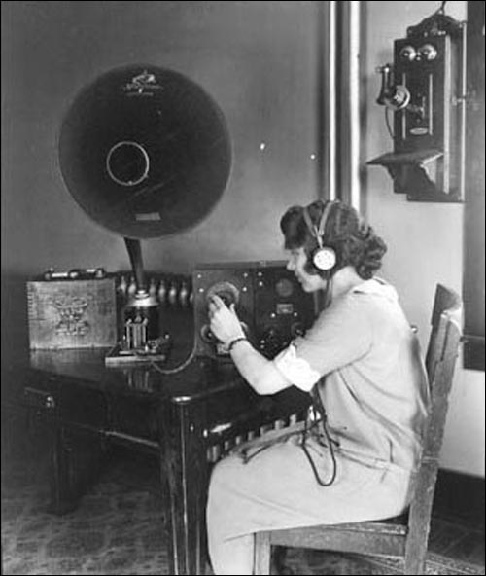
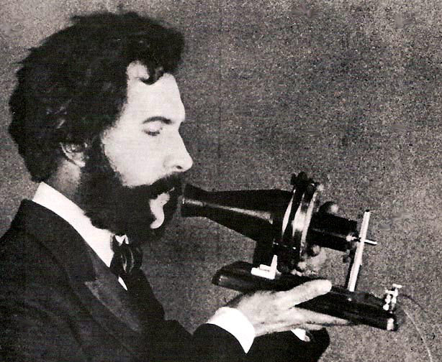
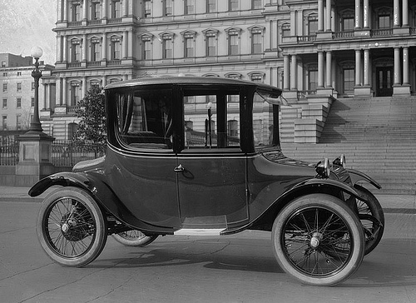
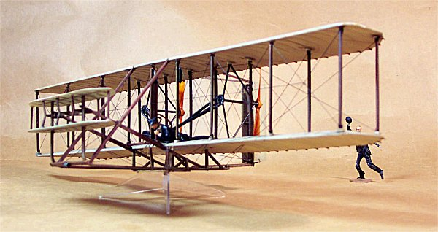
The Second Industrial Revolution – Technology Timeline
Lightbulb is developed.
Public lighting is available. For the public.
Radio developed (1910s).
1870s
1880s
1890s
1900s...
Telephone is invented (1876).
Automobile is developed.
Flyin’ machines invented.
back to selection

Slide 4
What sparked the Second Industrial Revolution?
STEEL
ELECTRICITY
Production led to:
▪ Improved transportation: production of automobiles and subways.
▪ Lighter and more durable building material for new constructs.
▪ Displacement of iron in production of machines and firearms.
Usage led to:
▪ Development of Thomas Edison’s incandescent light bulb in the 1870’s.
▪ Public lighting in major cities.
▪ New form of power and energy for industries, factories, generators, turbines, and motors.

Slide 5
Steel Production The Results
As the Bessemer Process allowed, the price of steel drastically dropped due to greatly increased manufacturing since the first industrial revolution, leading soon to steel replacing iron in many applications of construction.
More light and durable than iron, steel was a now relatively inexpensive material for usage of the infrastructure of buildings and other constructs, such as bridges and railroad tracks.
Steel was also used in parts for various machines, firearms, and inventions created and developed.
PRODUCTION RISES
COSTS FALL

Slide 6
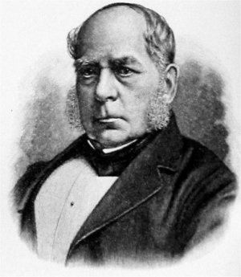
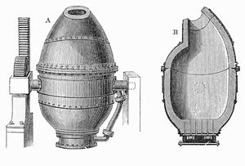
Steel Production The Bessemer-Kelly Process
Sir Henry Bessemer
Click for biographies.
Mass production of steel began with the introduction of a new process and machine created by two men known as Sir Henry Bessemer (1813-1898) and William Kelly (1811-1888).
Bessemer innovated the industry of steel manufacturing with the development of the Bessemer converter, which was used in conjunction with Kelly’s processes, allowing iron to be converted into steel from the removal of the iron’s impurities.
The efficient and relatively inexpensive method of steel production led to the usage of the now common steel in several other applications, including new inventions and machinery.
Bessemer Converter

Slide 7
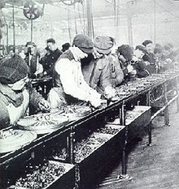
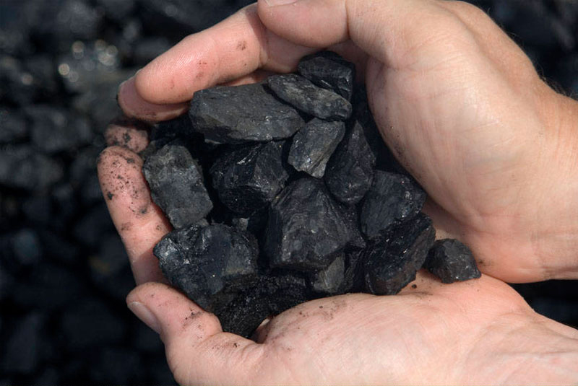
Electricity The Results
Production line of automobiles.
Public lighting would now be available due to electricity.
Along with this, lighting for personal use by normal consumers and factories was now available.
Electronic components, such as the conveyor belt and electrical motors, for factories were used as well for increased efficiency in production.
Electricity was a new power source that, for many countries, began to replace the coal of the first Industrial Revolution in usage.
Coal.

Slide 8
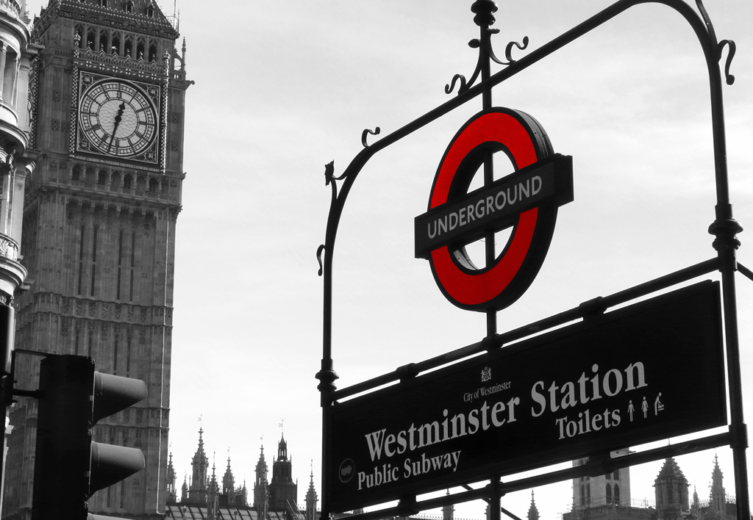
Electricity The Subways
The Metropolitan in France
Subways were also gradually being introduced and instituted within several countries.
These subways were entities of a combination between the two sparks of the industrial revolution of steel and electricity.
In France is the Metropolitan, and in England there is the London Underground.
Informational Pages
The Westminster Station in England

Slide 9
Other Technological Advances
RAILROADS
The construction of railroad systems during the Civil War which made transportation of goods, supplies, and materials more efficient.
OTHERS
This also included many other technological innovations for the two biggest matters of transportation and communication in the development of the airplane, telephone, and the radio.
The steam engine was gradually replaced by the steam turbine and the internal combustion engine for more efficient power.
Other contributions and important results of the second industrial revolution. These include chemicals contributing to the production plastics and improvement of dyes and textiles.
CHEMICALS

Slide 10
Why was Germany so successful?
People
Education of the people in fields involved in production and industry was common.
The government of Germany aided in the country’s industries and businesses.
Equipment
The equipment used for manufacturing was generally newer and more efficient than that of Britain and France, older leading nations in industry.
The railroad system instituted within Germany aided efficiency in transportation and communications.
Cartels
Unified groups of firms and companies, or cartels, completely overtook different industries and the production of goods that spurred Germany’s economy onward.
The demand for products increased as the population began to rise all across Europe.

Slide 11
Comparison of Leading Industrial Nations
France increased industrial production that equaled that of Great Britain’s a generation earlier by the beginning of the 20th century.
Germany economy boomed and production rates skyrocketed for several industries in which Germany became the leader due to the institutions of machines and factories as well as abundant resources within the country itself*.
The industrial production of the United States, just as that of Germany had, rapidly grew, as immigrants traveled in, new factories that were updated and more efficient were instituted, and the territory expanded to find its own abundance of natural resources used in industrial production.
The industry of Great Britain continued to gradually increase, but the relative lack of newer technologies and efficient machines, as well as the country’s ignoring of steel production led to a slower industrial growth compared to that of Germany and the United States.
*See charts on p. 741 of The Western Experience (Chambers) for visual comparison of industrial production.

Slide 12
Industry of Other Nations
ITALY
JAPAN
RUSSIA
SWEDEN
LIMITED RESOURCES
BEGAN INDUSTRIALIZING AS WELL
RELATIVELY RURAL/POOR
End of the section! Click to return to selection OR the review!

Slide 13
Role of Agriculture
Continuous role of agriculture in France, the Netherlands, and Sweden.
Increase specialization of agricultural industries (e.g. Denmark’s dairy industry).
Role of agriculture in Belgium, Germany, and Britain.
Increase in imports and results of institution of tariffs for agricultural and manufactured goods.
Increase in price of cotton [Egyptian Cotton] due to American Civil War.
back to selection

Slide 14
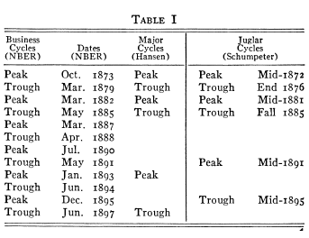
The Long Depression
PRICES &
PROFITS
PRODUCTION & COSTS
The second industrial revolution occurred during a time of deflation and a depression from 1873 to 1896, known as the Long Depression, caused by many factors.
These factors include the collapse of Vienna’s Stock Exchange, the Franco-Prussian war, the increased industrial production across Europe.
Peak is the highest point and trough is the lowest point of the economy (“The Long Depression of 1873…”)
End of the section! Click to return to selection OR the review!

Slide 15
Demographic Trends and Changes of the 19th century
BIRTH RATES
DEATH RATES
POPULATION
Birthrates began to decrease overall, as forms of contraception were being used, quality of life for the majority (especially the bourgeois) improved, and values of the upper classes were being imitated by the bourgeois in having less children.
Death rates decreased as well due to the industrialization of the period, the improving diets of the majority of the population of Europe, and the improvements in medication available for the public.
back to selection

Slide 16
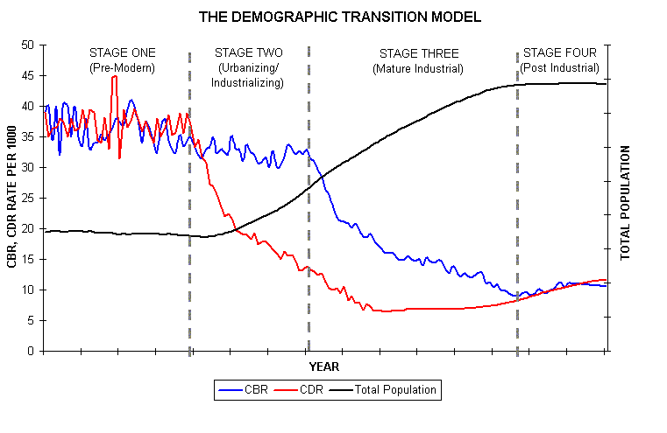
Demographic Transition
Demographic transition: As the term suggests, it is a transition in the demographics of a population from high birth and death rates to low birth and death rates.
“ French mortality rates did decline—from 25.3 per 1,000 between 1816 and 1820 to 18.3 per 1,000 during the period from 1911 to 1913. However, the birthrate declined more—from 32.9 per 1,000 from 1816 to 1820 to 18.8 per 1,000 from 1911 to 1913…” (19th-Century French Economy…”).
A model of demographic transition (“Montgomery”).
End of the section! Click to return to selection OR the review!

Slide 17
The Review
Germany’s industrial production rapidly grew because of all of the following reasons EXCEPT:
Germany took advantage of steel production.
The government assisted in industrial affairs.
Immigrants helped spur economic growth with increased production rates.
New and efficient equipment was instituted within factories.
Both A and C
The country that produced steel and used electricity the least during the period was:
France
Germany
‘Murica
Britain
None of the above (umm….)
All of the above (what are you doing?)
Which of the following is NOT true?
Germany and the United States began to lead industrial production in Europe.
The decrease in agriculture in Britain and Germany led to increased imports.
Railroad systems allowed for more efficient transportation of goods and materials.
Both A and C
All of the above
None of the above
Demographic transition is a trend that goes:
From low birth rates to high birth rates.
From high birth rates to low birth rates.
From low mortality rates to high mortality rates.
From high mortality rates to low mortality rates.
Both A and C.
Both B and D.
Yes. (all of the above are true)

Slide 18
CORRECT
Triumph once again, master. (back to the review)
or
Be liberated from the fetters of THE SYSTEM (arrggh).

Slide 19
WRONG
Return whence you came, peasant.
(Back to review)
or
Be henceforth banished from these lands!

Slide 20
Works Cited
"19th-Century French Economy and Society, Industrialization in France." Industrialization in France. N.p., n.d. Web. 30 Jan. 2013. <http://www.countriesquest.com/europe/france/history/france_in_the_late_middle_ages/the_reshaping_of_france/19th-century_french_economy_and_society/industrialization_in_france.htm>.
"Bessemer Process (metallurgy)." Encyclopedia Britannica Online. Encyclopedia Britannica, n.d. Web. 30 Jan. 2013. <http://www.britannica.com/EBchecked/topic/63067/Bessemer-process>.
Chambers, Mortimer. The Western Experience. 9th ed. Boston: McGraw-Hill, 2003. Print.
"Deflation." Deflation. N.p., n.d. Web. 29 Jan. 2013. <http://www.martinfrost.ws/htmlfiles/oct2008/deflation-explained.html>.
The Industrial Revolution in the United States. N.p.: Library of Congress, n.d. PDF.
Lequin, Yves. "Article - Electricity." Article - Electricity. N.p., n.d. Web. 31 Jan. 2013. <http://www.memo.fr/en/article.aspx?ID=THE_TEC_011>.
"London Underground's History." Time Out. N.p., n.d. Web. 31 Jan. 2013. <http://www.timeout.com/london/things-to-do/london-undergrounds-history-2>.
"The Long Depression of 1873: Parallels and Comparisons. Are We Missing Economic Information from an Important Piece of American Financial History?" My Budget 360 RSS. N.p., n.d. Web. 30 Jan. 2013.
Mokyr, Joel, and Robert H. Strotz. The Second Industrial Revolution, 1870-1914. N.p.: n.p., Apr. 1998. PDF.
Montgomery, Keith. "Demographic Transition." Demographic Transition. N.p., n.d. Web. 30 Jan. 2013. <http://www.uwmc.uwc.edu/geography/demotrans/demtran.htm>.
"19th Century." 19th Century. N.p., n.d. Web. 29 Jan. 2013. <http://www.princeton.edu/~achaney/tmve/wiki100k/docs/19th_century.html>.
"The Paris Metro System." The Paris Metro (subway) System - Part 1. N.p., n.d. Web. 30 Jan. 2013. <http://www.discoverfrance.net/France/Paris/Paris_metro.shtml>.

Slide 21
Pictures Used
http://gallery.scalemodel.net/WrightFlyer/WrightFlyer.jpg
http://www.toptenz.net/wp-content/uploads/2010/08/first-telephone.jpg
http://www.ecoelectrons.com/Portals/73191/images/Electric%20car%20is%20a%20hoax-resized-600.jpg
http://us.123rf.com/400wm/400/400/claudiodivizia/claudiodivizia0905/claudiodivizia090500070/4846579-diamond-steel-plate-useful-as-a-background.jpg
http://www.mrgallagherstudentsites.com/1910s/wp-content/uploads/2011/05/acyb05-06_0004.jpg
http://www.how-things-work-science-projects.com/images/lightening_500x332.jpg
http://upload.wikimedia.org/wikipedia/commons/thumb/1/10/Henry_Bessemer.jpg/220px-Henry_Bessemer.jpg
http://upload.wikimedia.org/wikipedia/commons/thumb/6/61/Bessemer_converter.jpg/300px-Bessemer_converter.jpg
http://netrightdaily.com/wp-content/uploads/2010/09/Coal.jpg
http://www.nwcouncil.org/history/images/railroad.jpg
http://upload.wikimedia.org/wikipedia/commons/thumb/2/29/Ford_assembly_line_-_1913.jpg/220px-Ford_assembly_line_-_1913.jpg
http://www.traveljournals.net/pictures/l/15/155925-a-cool-metro-subway-sign-paris-france.jpg
http://media.smashingmagazine.com/wp-content/uploads/uploader/images/signs/westminster-underground/full_westminster-station.jpg
http://fc00.deviantart.net/fs71/f/2012/323/c/e/russia_grunge_flag_by_syndikata_np-d5gx10s.jpg
http://wesleytb.files.wordpress.com/2010/02/swedish_flag.jpg
http://www.desktopwallpaperhd.net/wallpapers/9/a/thread-video-wallpaper-think-grunge-italy-flag-94746.jpg
http://images2.fanpop.com/image/photos/13500000/Great-Britain-Flag-great-britain-13511739-1920-1200.jpg
http://www.germanpulse.com/wp-content/uploads/2011/07/german-flag.jpg
http://fc02.deviantart.net/fs70/f/2011/231/0/1/united_states_usa_flag_by_think0-d4759zm.jpg
http://fc05.deviantart.net/fs70/f/2012/186/c/8/france_flag_by_think0-d563k6e.jpg
http://www.chemheritage.org/Discover/Collections/Collection-Items/Fine-Art/asset_upload_file813_67877.jpg
http://mechanical-engineering.co/wp-content/uploads/2012/05/Parsons-steam-turbine-rotor2.jpg
http://www.gridconnect.nl/images/stainless_steel_wallpaper_by_brentpeters-d3044sc.jpg
http://www.imgbase.info/images/safe-wallpapers/photography/miscellaneous/13097_miscellaneous_grain.jpg
http://pjmedia.com/tatler/files/2011/07/light-bulb.jpg

